Slide 1
Investigation CRT Technology: Using a Magnetic Field to Measure Pixel Pitch
Anthony Mollica
UBC Physics
Physics 420 February 11, 2010

Slide 2
Presentation Outline
Goals of this lab
Overview of CRT Technology
Calculation of Theoretical Vertical Pixel Pitch (∆x)
Electromagnetic Physics Theory
Experimental ∆x Determination
References
Summary
2

Slide 3
Goals for this Lab
Our goal is to learn about electromagnetic theory
Key concepts include:
Field lines
Cross product direction
Magnetic force
Magnetic field dependence on distance
Integration of other Physics concepts, Mechanics, and Kinematics
This will be achieved experimentally through exploring CRT technology
We will integrate these concepts to calculate vertical dot pitch ∆x
3

Slide 4
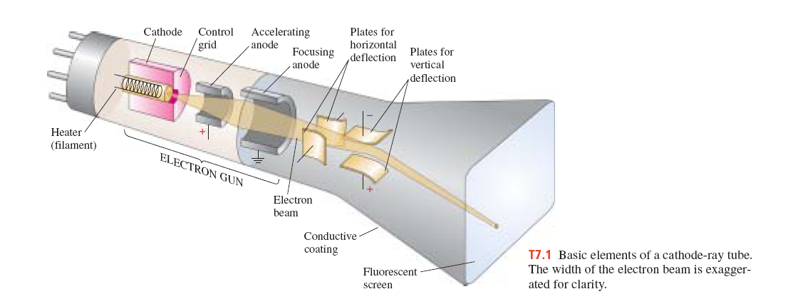
How Does a CRT TV Work?
CRT stands for Cathode Ray Tube
Components of a CRT TV
Electron gun: Speeds up electrons
Magnets: There are horizontal and vertical magnets to deflect the electrons
Phosphor filaments on the screen that the electrons hit
4

Slide 5
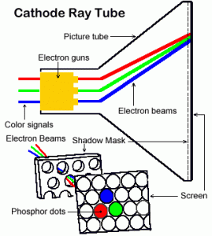
Light Emission from a CRT
Electrons are move at ~1/3 speed of light
The interior of the computer screen is a Vacuum
Electrons are deflected by magnets targeting dots on the screen
Kinetic energy of the electron transferred to light energy
Red, blue or green is created
5

Slide 6
Primary Colours Create all Colours
Red, blue and green are created from the electron beam
Mixtures of primary colours can create all colours
http://cbu.edu/~jvarrian/applets/color1/colors_g.htm
6

Slide 7
Why is the image continuous?
From distance the eye cannot see individual dots
3 dots (R,G,B) cluster together and form a pixel
Pixels can therefore produce any colour
Many pixels produce an image
Pixel
Dot
7

Slide 8
How the CRT Fools the Eye
3 primary colours look like one colour
How the screen is refreshed
http://www.magnet.fsu.edu/education/tutorials/java/crt/index.html
Electron gun hits the each pixel 60 times in a second
0.017 seconds per pixel refresh
Animation analogy: Flip book birdcage
http://www.youtube.com/watch?v=-UVbL-sDGFA&feature=PlayList&p=982BF9D4EE169B15&playnext=1&playnext_from=PL&index=1
Brightness of each dot controlled by electron accelerating voltage
8

Slide 9
Calculation of Dot Pitch Theoretical ∆x
Dot pitch is the diagonal distance between dots of the same colour (DP)
Vertical dot pitch is vertical distance between same colour dots
For this lab we are interested in Vertical Dot Pitch
We will call the Vertical Dot Pitch ∆x for this lab
*Not to Scale
DP
∆x
DP
(∆x)(3/2)
∆x/2
60°
9

Slide 10
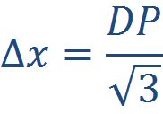
Results of Theoretical ∆x Calculation
A reference value for Dot Pitch (DP) 0.20mm
Using our expression we find that:
We can then say that ∆x is theoretically
~0.12mm
10
Notes:
Let them find the DP etc

Slide 11
How Electrons in a CRT are Deflected
Direction of Deflected Electrons Given by Cross product or Right Hand Rule (RHR)
Path of electron (v_{x})
*since v, and B are perpendicular
Magnetic Field (B)
*Direction Force (F)
*Negative Charge Flips force downwards
11
Notes:
Let them find the direction of F

Slide 12
Magnetic Field of a Ring Magnet
Magnetic Field around a ring magnet
Force by deflects electrons downward RHR
Magnetic Field (B)
F
v_{y}
B
12

Slide 13
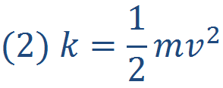
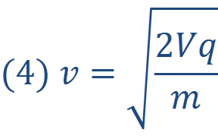
The Kinetic Energy of an Electron
K Kinetic Energy of electron (J)
m mass of an electron (kg) 9.1x10⁻³¹ kg
v is the velocity electron (m/s) ~1.0x10⁸ m/s
In an electron gun K given by accelerating voltage
V is the accelerating voltage (V, J/C) ~20-40kV
We will use 30kV
q is the fundamental charge 1.60x10⁻¹⁹ C
13
Notes:
Let them figure out how to solve for (4)

Slide 14
Experimental ∆x Derivation I
Newton’s 2nd Law tells us:
V
Δx
B
y
We can relate this to our magnetic force:
V_{y}
Using Kinematics we know:
This means into the page
14

Slide 15
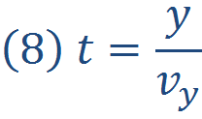
Experimental ∆x Derivation II
Since v_{y} is large:
V
Δx
B
Time it takes the electron to cross y:
V_{y}
Subbing for t, a, F:
15

Slide 16
Measuring our Magnetic Field Experimentally
We measure magnetic field with a Gauss Meter
The field has direction so we will need to orient probe properly
In this case parallel to the field lines (see Diagram)
If the field is negative field line is moving away from the probe
Not Important we are only interested in |B|
0.2cm 0.4cm 0.6cm….
16

Slide 17
Summary
CRT technology 3 dots to make a pixel
These dots are primary colours and form other colours
Magnetic fields cause deflections of charged particles
The direction of the force is given by the right hand rule or cross product
CRT technology uses magnets to deflect electrons on the screen
These laws can be used to predict the distance between CRT dots
17

Slide 18
References
CRT Picture Slide Physics 420 Electron Deflection.pdf
CRT Diagram http://www.highdisplay.com/wp-content/uploads/2009/11/crt-computer-monitor-269x300.gif
Griffiths Introduction to Electrodynamics Third Edition
CERN Teachers Lab: Cathode Ray Tube
Topic 7: Cathode Ray Tube http://wps.aw.com/wps/media/objects/877/898586/topics/topic07.pdf
LakeShore Model 410 Gaussmeter User Manual
Giancoli Physics Third Edition
18

Slide 19
Questions?
19

